Slide 1
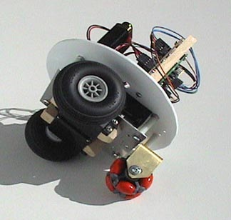
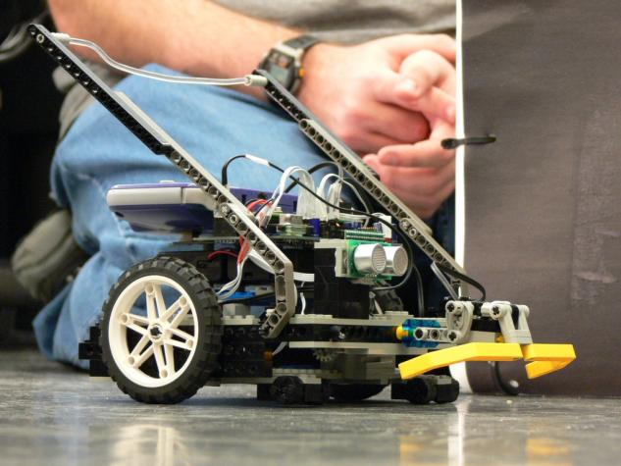
Mobile Robot Bases

Slide 2
Types of Mobile Robot Bases
Ackerman Drive
typical car steering
non-holonomic

Slide 3
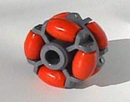
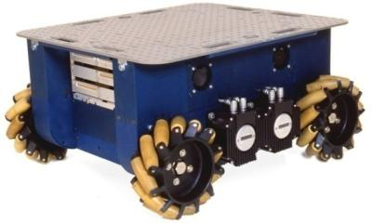
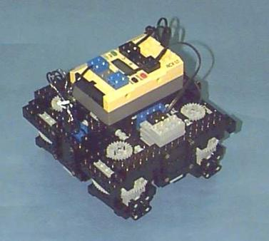
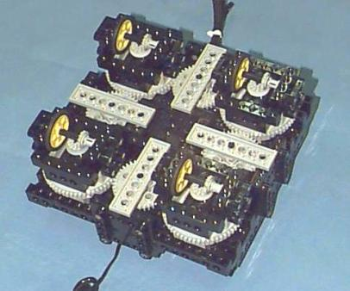
Types of Mobile Robot Bases
Omni Drive
wheel capable of rolling in any direction
robot can change direction without rotating base
Synchro Drive

Slide 4
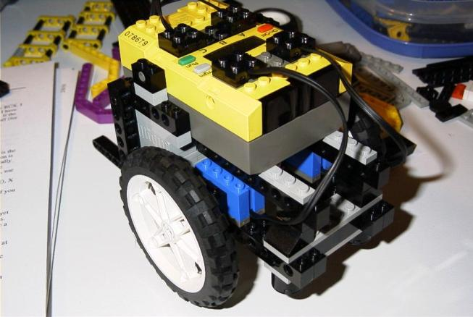
Types of Mobile Bases
Differential Drive
Two independently driven wheels on opposite sides of the robot
3 DoF: pose = [x,y,Θ]
Holonomic: can be treated as a massless point that can move in any direction

Slide 5
Types of Mobile Robot Bases

Slide 6
Gear motor with 24T gear in the Frame
Picture courtesy of Terry Grant

Slide 7
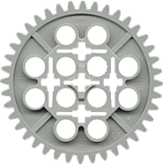
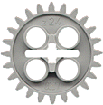
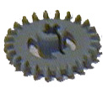
LEGO Gears
40T
8T
16T
Bevel
1T Worm
24T
24T
Crown

Slide 8
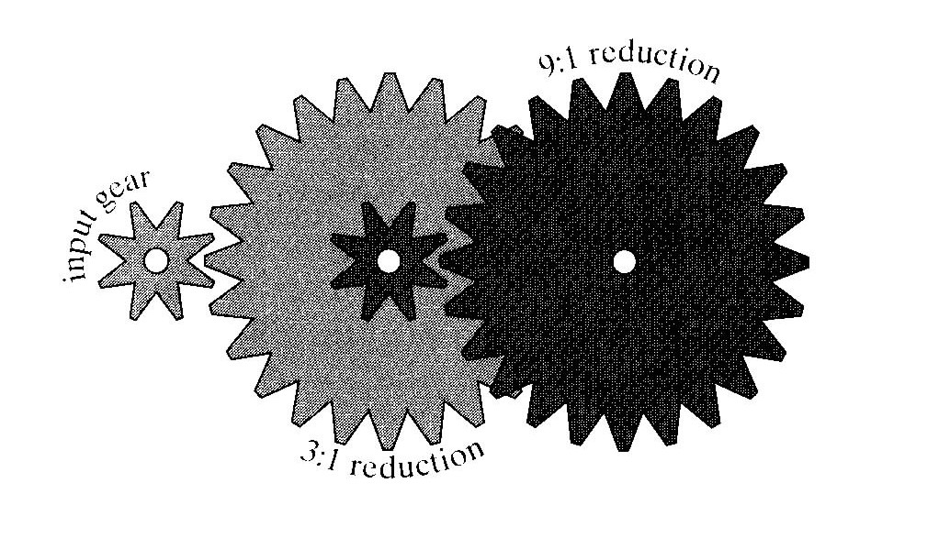

Slide 9
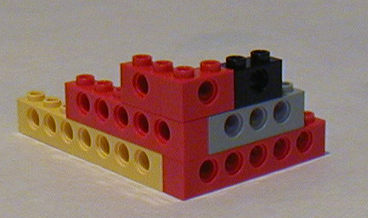
Lego tips: Structure
Common pitfall when trying to increase mechanical robustness:

Slide 10
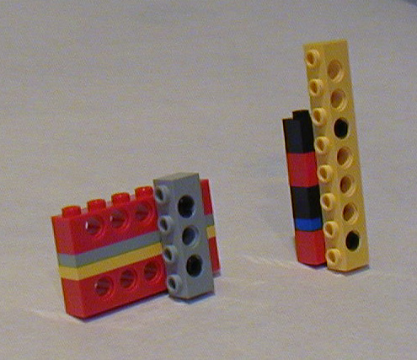
Structure
The right way:

